Slide 1
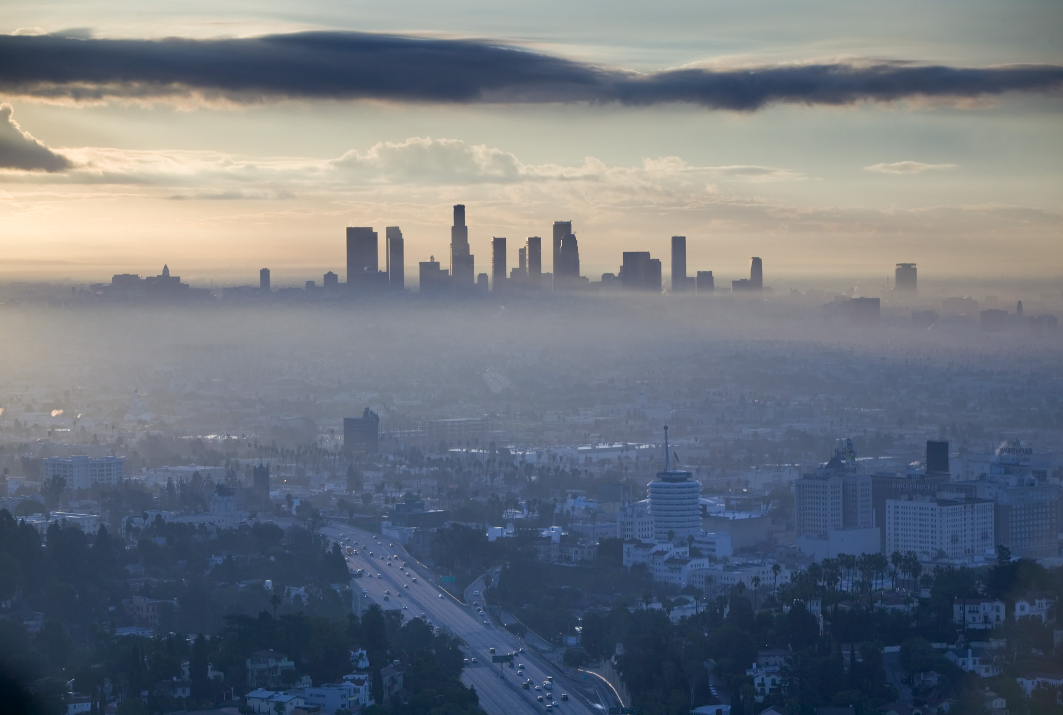
Decreasing Ozone in Los Angeles
By Deven Morris

Slide 2
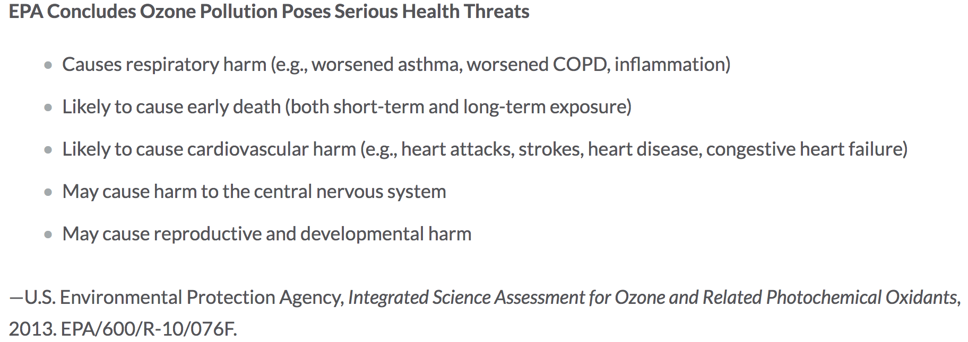
Hazards of Ozone

Slide 3
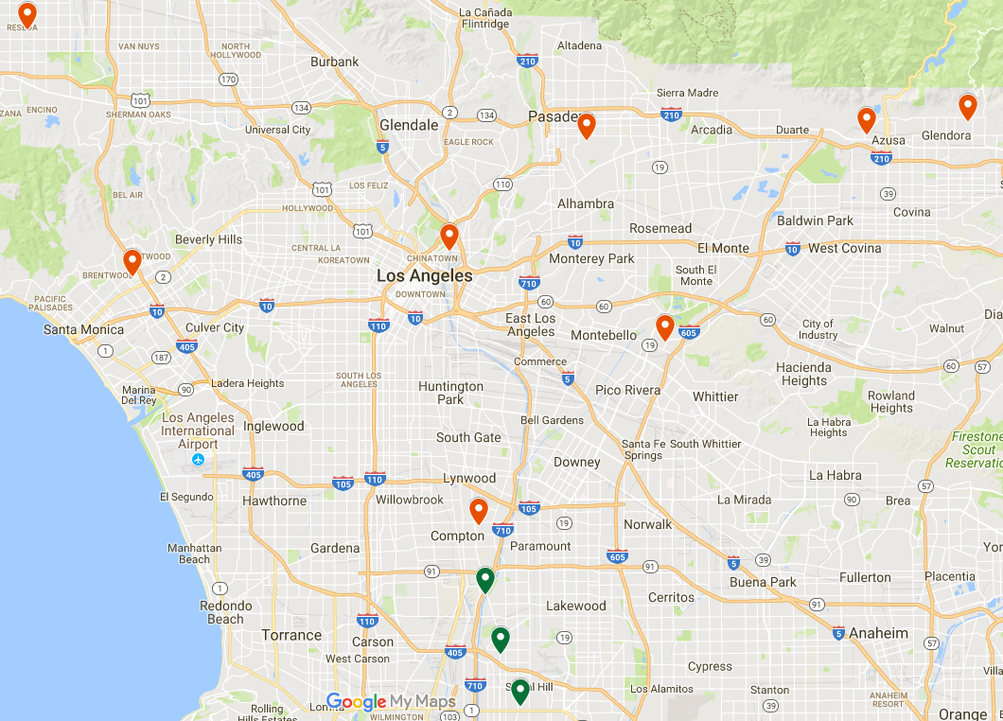
Area Concerned

Slide 4
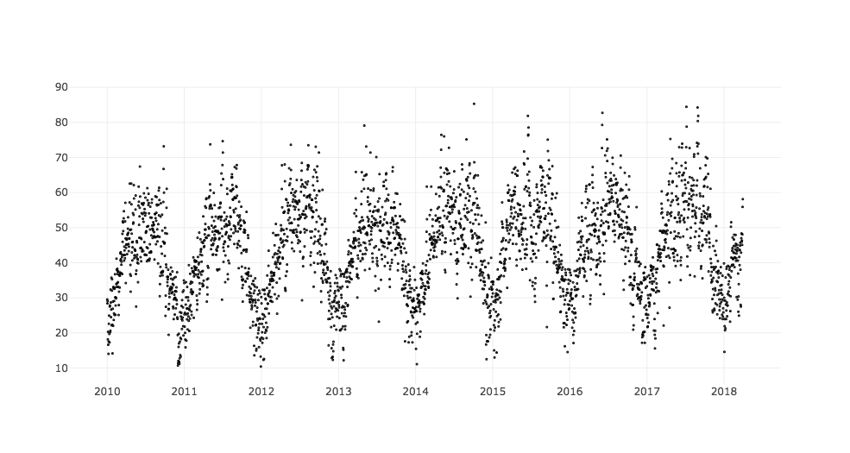
Data
Ozone ppb
Year

Slide 5
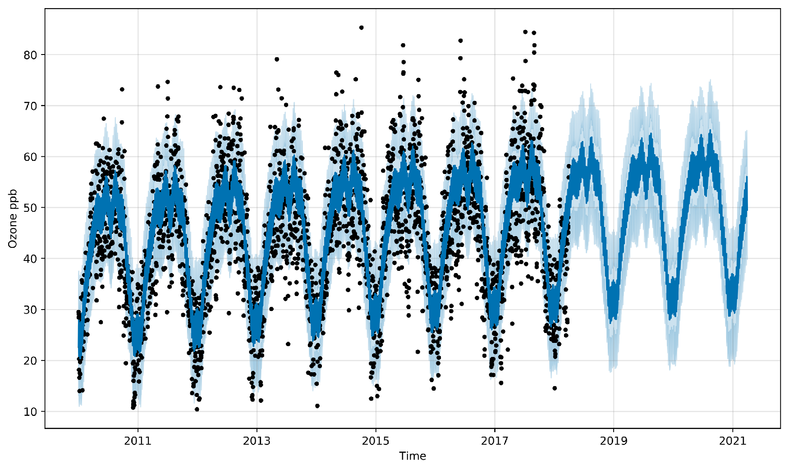
Model Fit

Slide 6
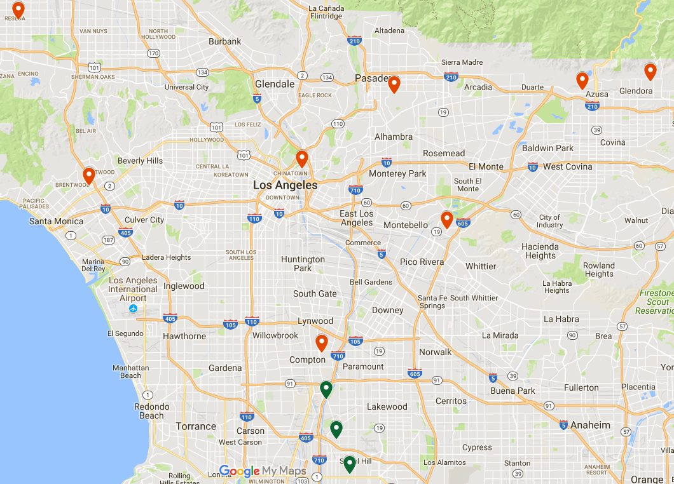
Sites of Interest
60370002

Slide 7
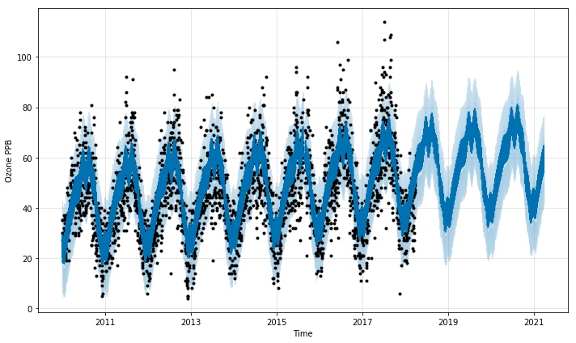
Site 60370002

Slide 8
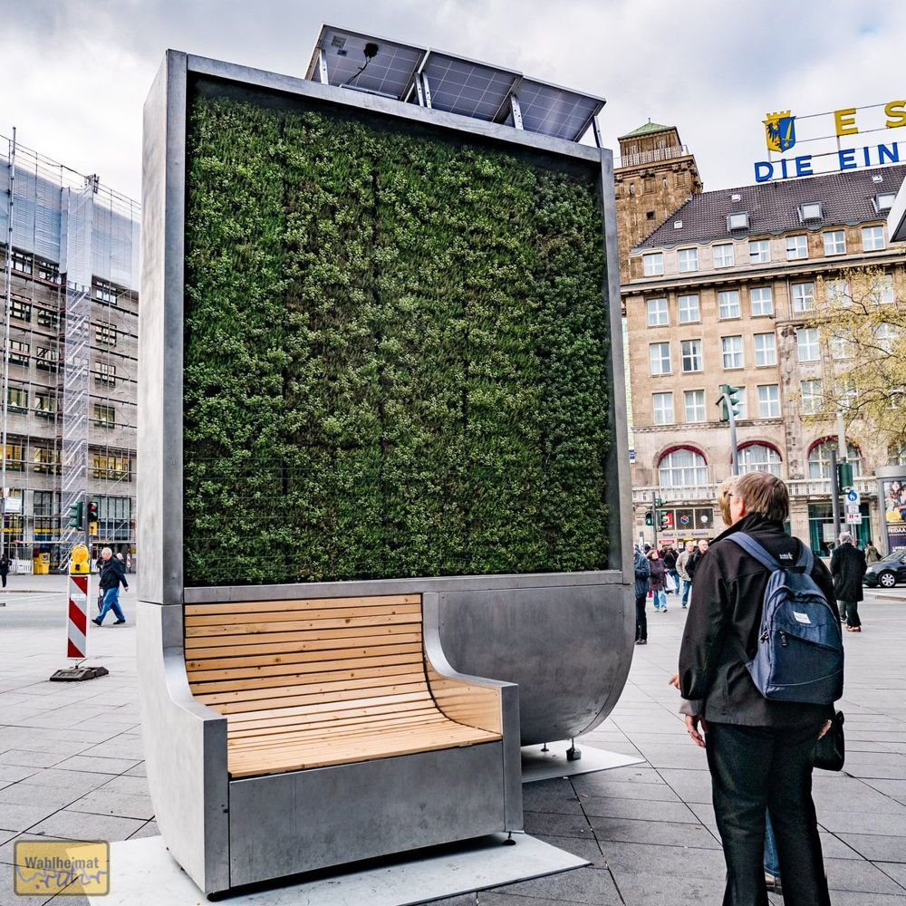
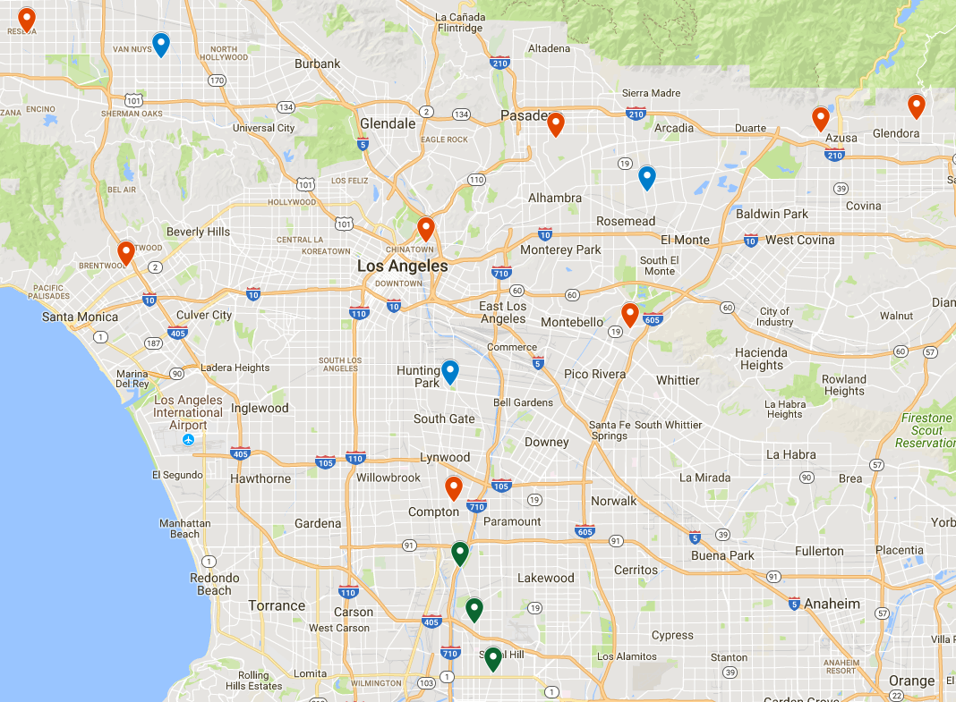
Recommendations
CityTree

Slide 9
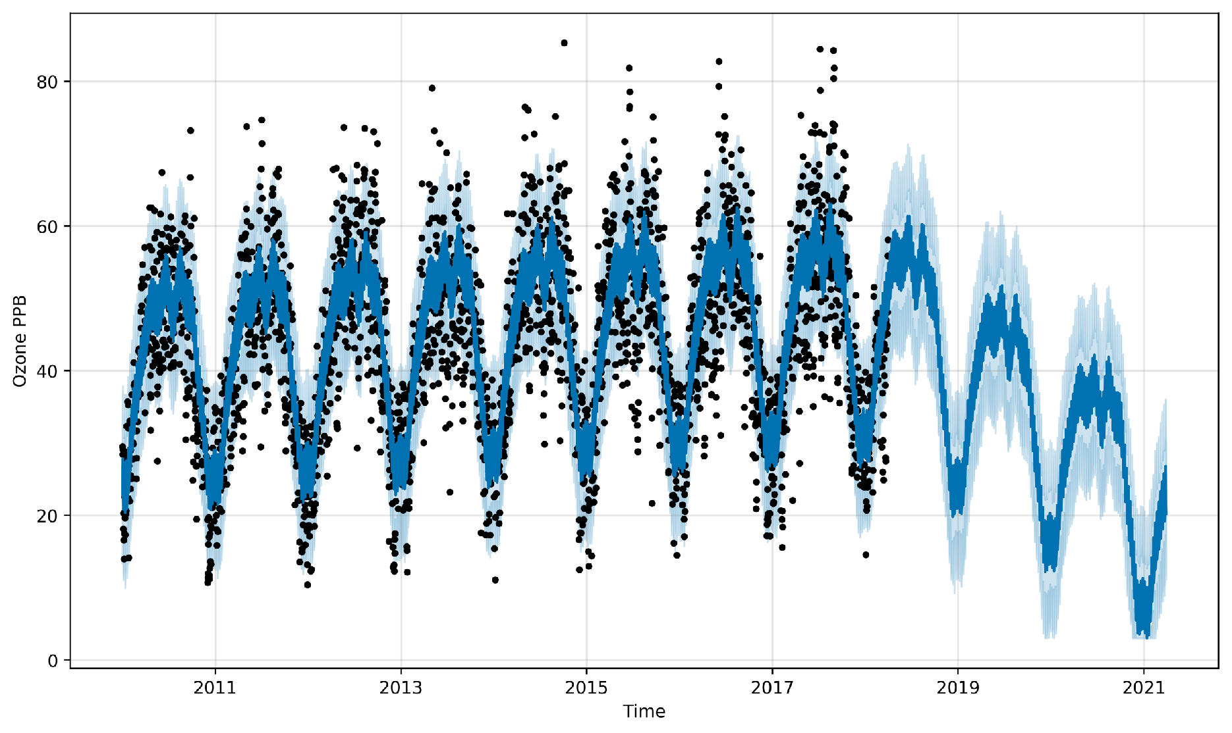
Projected L.A. Trend

Slide 10


Next Steps
Investigate Causes
Apply to other cities

Slide 11


Thank You!
Deven Morris
djmorcode@gmail.com
913-710-7753
djmor12/
djmor/
Data: Ozone, Ozone2, News, Hazards Research: Abs. Rates, Generators, AQI
Green Tech: CityTree, Vertical Forest, General

Slide 12
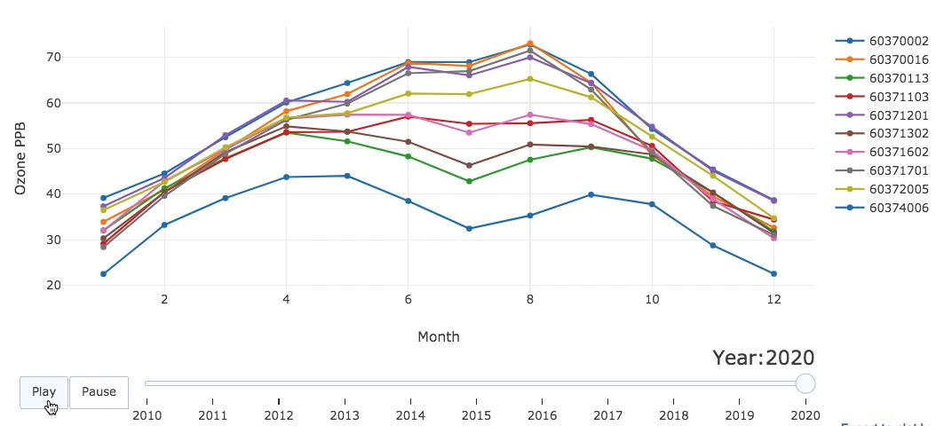
Ozone Change over Time

Slide 13
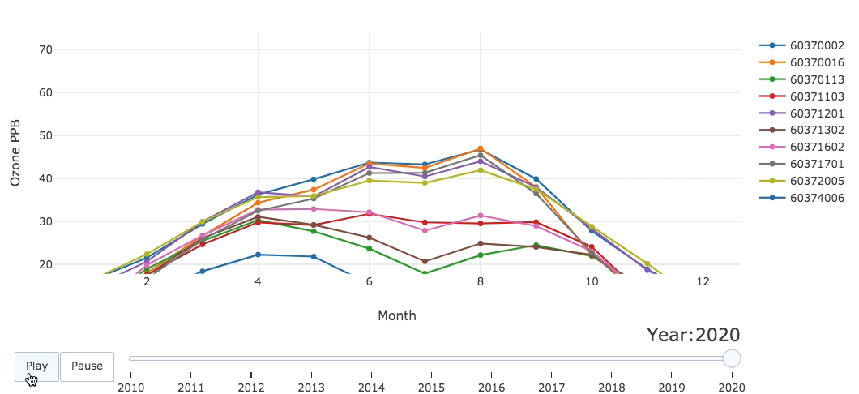
Ozone Change over Time

Slide 14
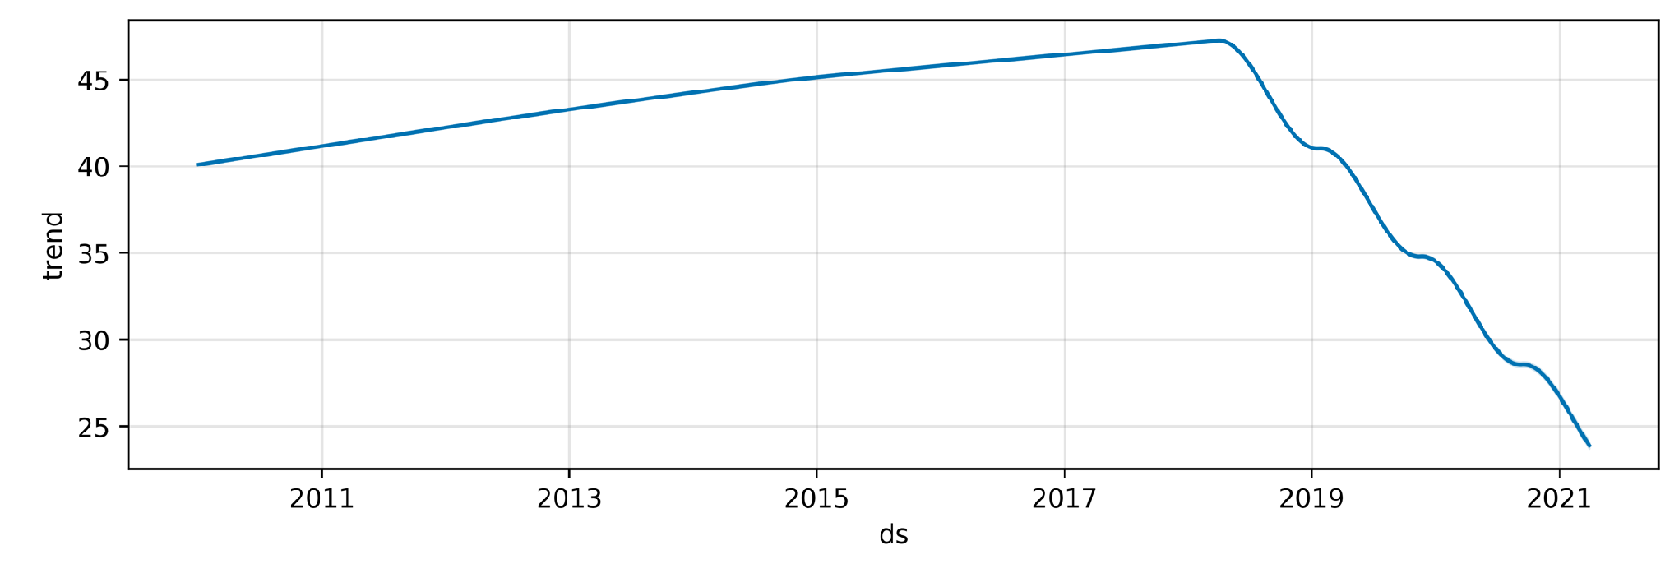
Project Trend: 3 CityTrees

Slide 15
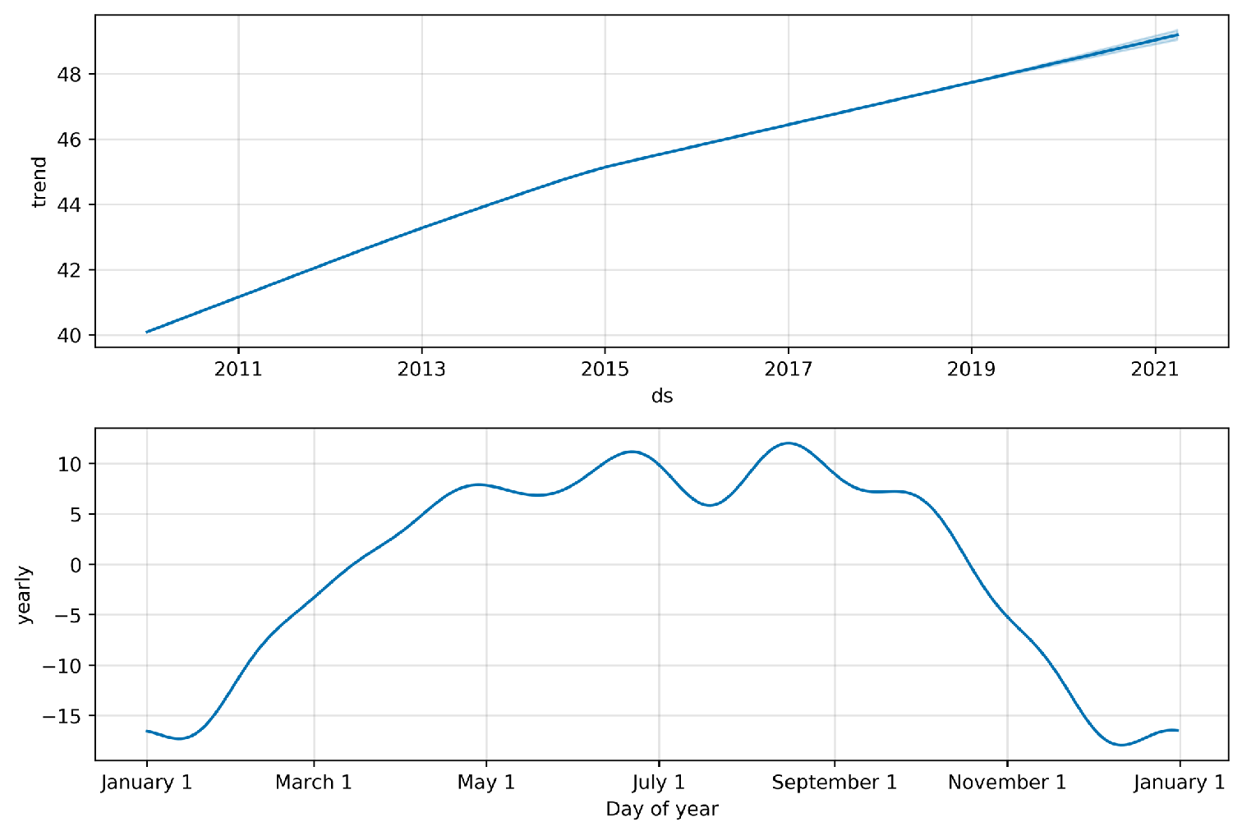
Model Fit Components

Slide 16
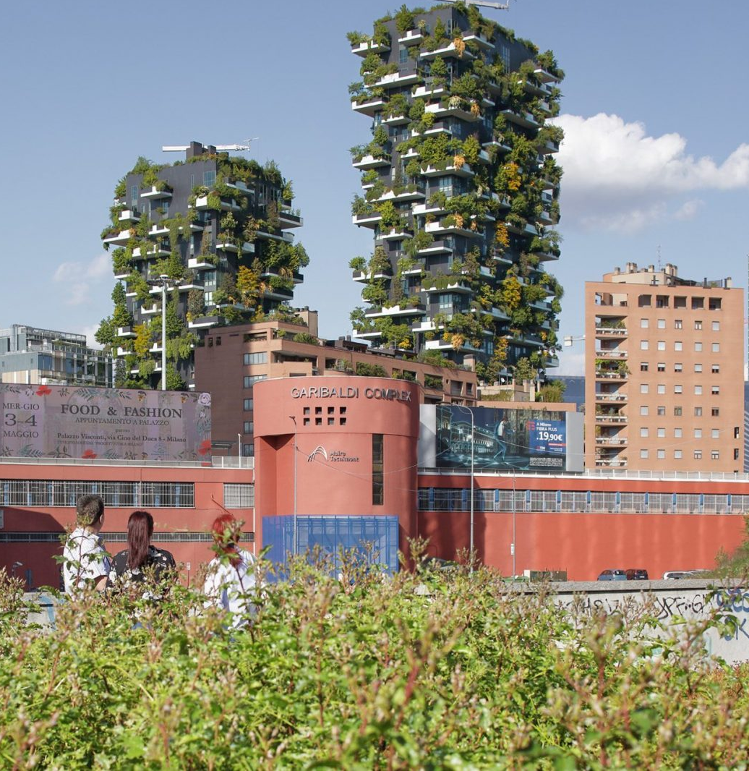
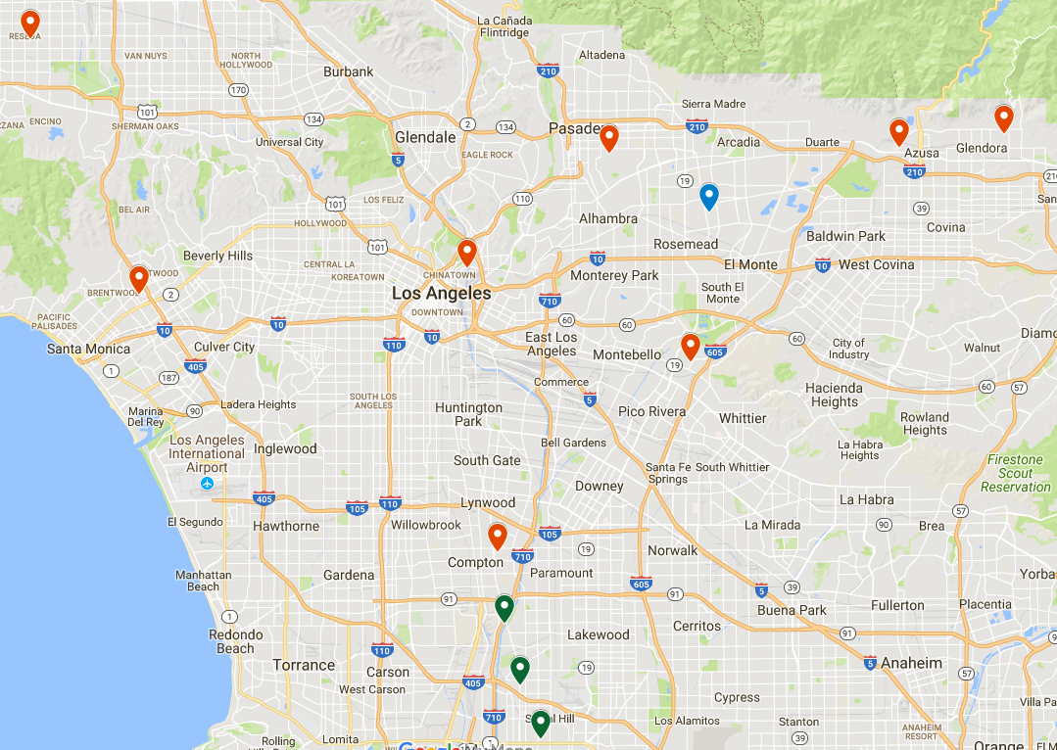
Recommendations
Vertical Forest

Slide 17
Projected Trend: Vertical Forest

Slide 18
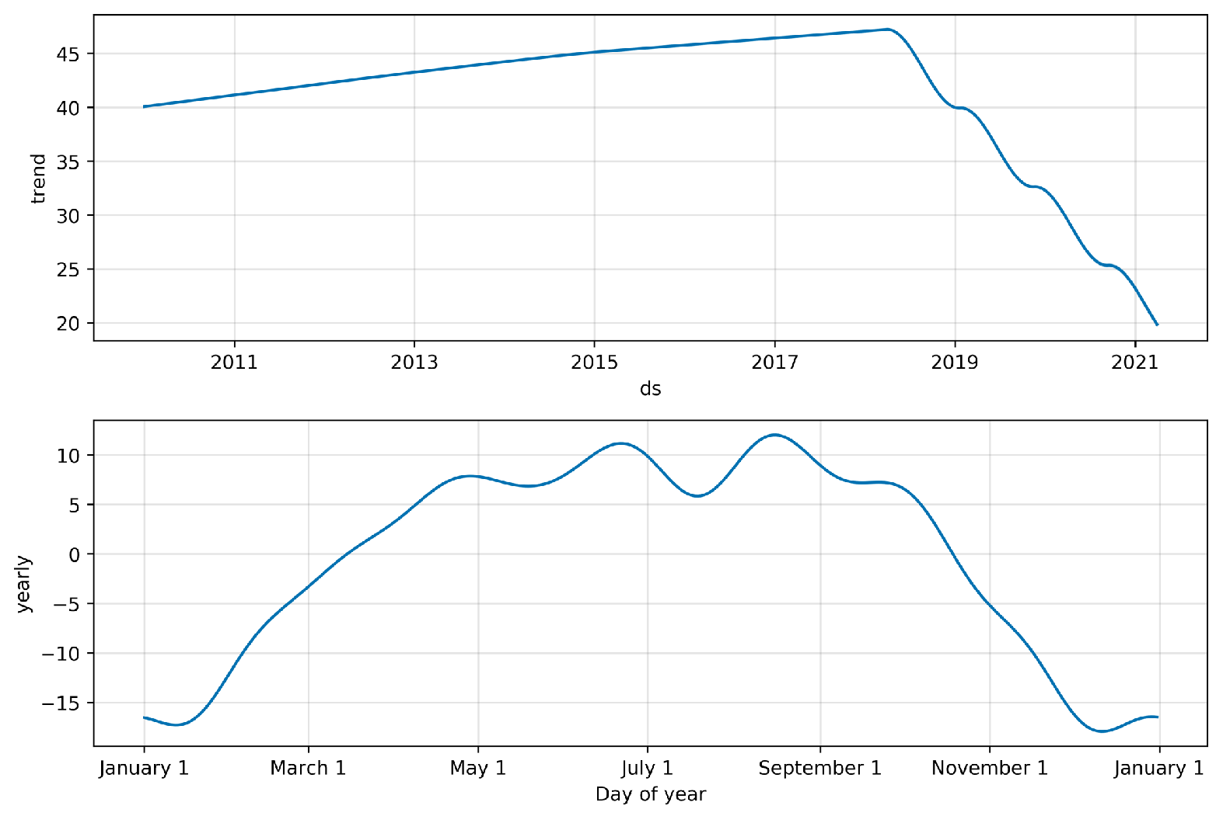
Projected Trend: Vertical Forest

